Slide 1

Annual Review
Contoso Customer Success Team September 3, 20XX

Slide 2
Agenda
01. Introduction
02. Results from last year
03. Team
04. What's next
05. Closing

Slide 3

Introduction
Profits are up, and losses are down! We are very proud of the progress our team has made. Today we’ll review our wins and losses from last year and give you an overview of what you can expect for next year.

Slide 4
Summary
Our business is good
Profits are up in the last quarter by 3%
We’re delivering for our customers
Last year we supported thousands of customers and sold 60,000 units
We’re getting our work done
We finished the consolidation project
Our customers keep coming back
We increased customer retention by 4%
We’re leaders
We are top leaders in the industry across the board

Slide 5
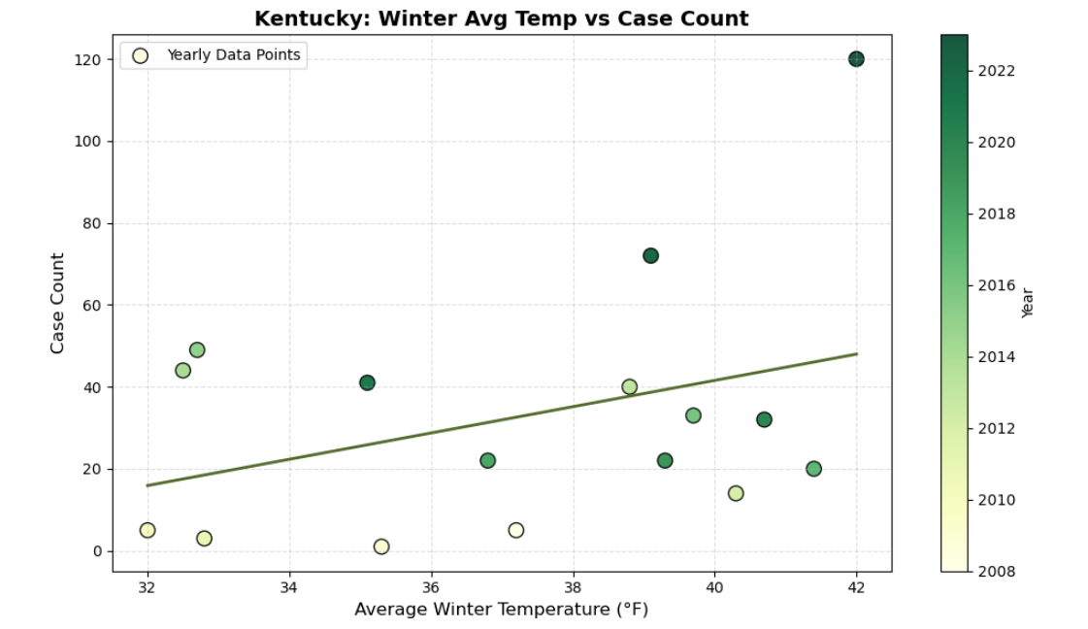
Growth by sector table

Slide 6
Growth by sector chart

Slide 7
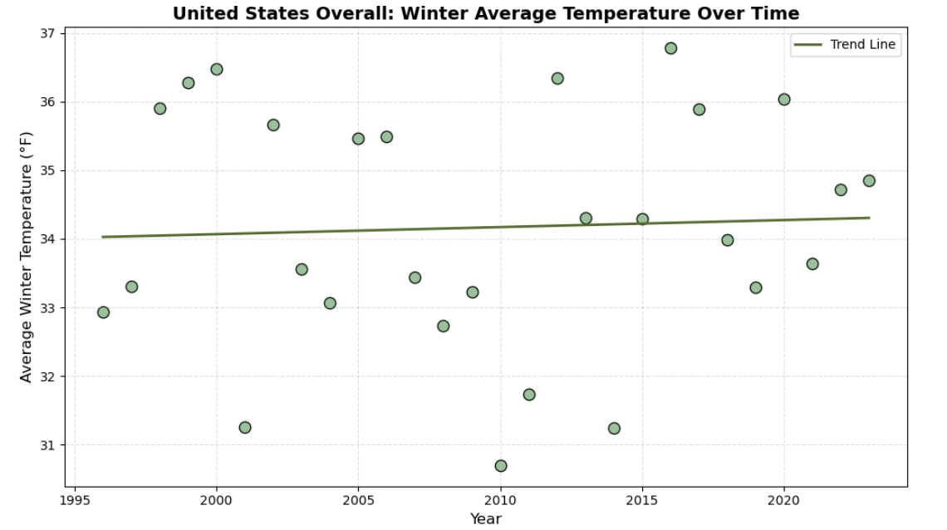

Slide 8
Growth by sector chart

Slide 9




Our team
Portrait of a team member
Ana
Larissa
Roman
Federico
CEO
CFO
CTO
COO

Slide 10
Goals for Q1
Business priorities
Employee opportunities
Increase customer satisfaction by 2%
Maintain growth
Diversify investment in sector 2
Initiative partnership with 3rd party organizations
End of fiscal celebration on July 15th
Employee day of learning on August 14th
Employee Yoga on September 3rd
Seminar series begins September 10th

Slide 11
Goals for Q1

Slide 12
Goals for Q2
Business priorities
Added priorities
Employee opportunities
Increase customer satisfaction by 2%
Maintain growth
Decrease the number of rotations by at least 2
Ensure the cost of development stays below budget
Interns begin
Indoor rec leagues
Chess tournaments
Big Game watching party
Food drive

Slide 13

Thank you
Thanks to your commitment and strong work ethic, we know next year will be even better than the last.
We look forward to working together.
Contoso
sales@contoso.com

